Slide 1
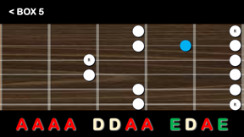
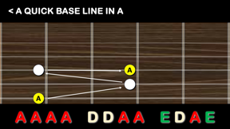
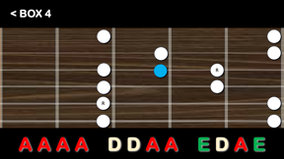
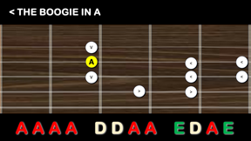
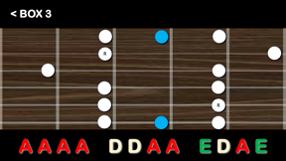
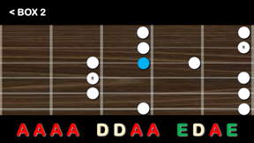
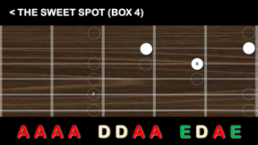
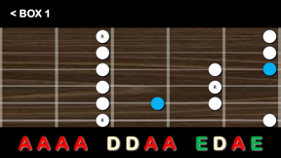
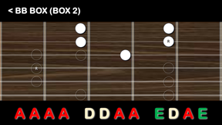

Slide 2


^{< WELCOME TO} PLAYING BLUES GUITAR AT HOME
PLEASE
NAME ON MASKING TAPE
BAGS AND STUFF ON THE DESKS
BEND BACK ANY STRINGS ON MACHINE HEAD

Slide 3
< INTRODUCTIONS
PLEASE SHARE YOUR NAME AND WHY YOU ARE HERE
INFORM US OF WHAT KEY QUESTION YOU HAVE

Slide 4




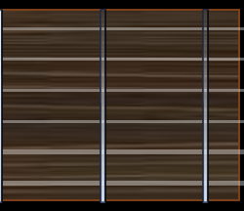
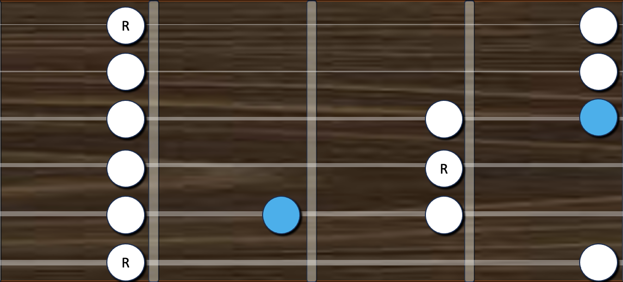
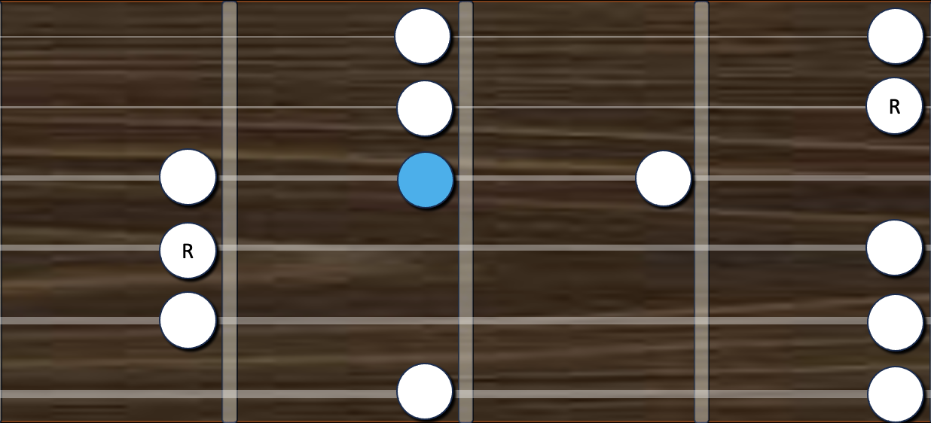
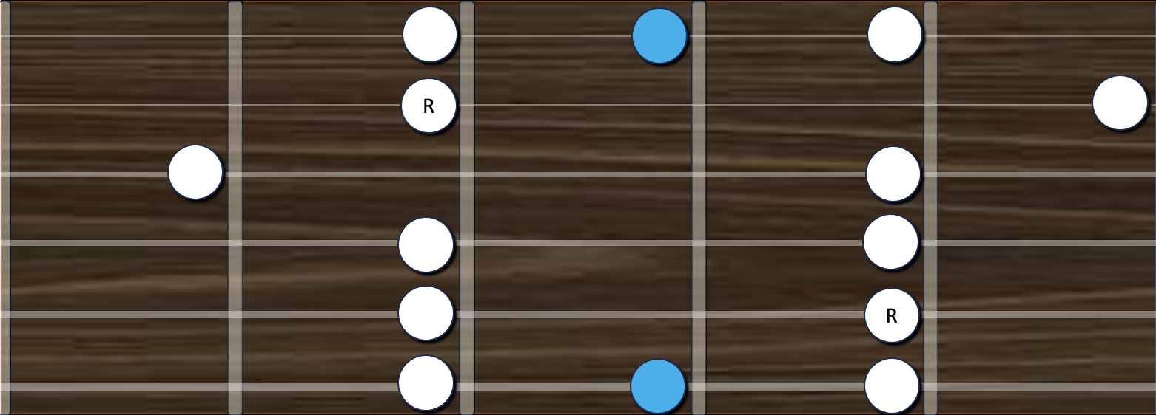
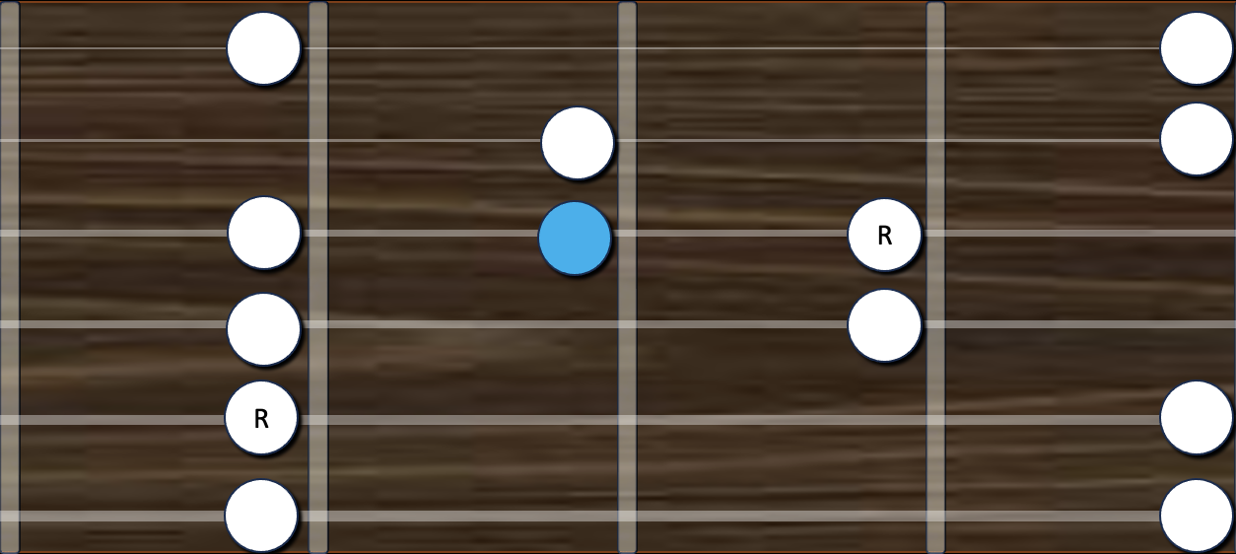
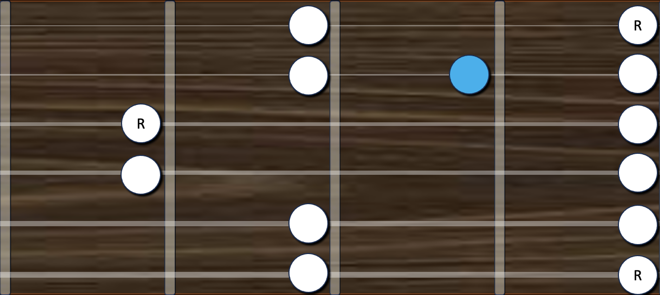
< OCTAVE FRETBOARD
An octave is the span of vibrations from one note's frequency (pitch) to another that is; double its frequency (going up) or half its frequency (going down). The use of 'octo' (8) is an irrelevant elitist monk convention. A major or minor scales have 7 notes and 7 intervals. The pentatonic scales have 5 and the blues scale has 6. The 'spacing' of these intervals (between notes) give different 'scales' across different cultures there feel, flavours and mood. Scales array their notes inside an 'octave' which is 12 semitones … 12 frets.
< THE SPIRAL THING
< THE SPIRAL THING
< THE 6 STRINGS
< THE 6 STRINGS
I
II
III
IV
V
VI
VII
< THE 7 NOTES
< THE 7 NOTES
< THE BLUES NOTE
< THE BLUES NOTE
E
B
BOX 1
BOX 1
BOX 2
BOX 3
BOX 4
BOX 5
BOX 1
BOX 2
BOX 3
BOX 4
BOX 5
BOX 1
BOX 5
BOX 1
BOX 5
G
BOX 2
BOX 3
BOX 4
BOX 2
BOX 3
BOX 4
BOX 2
BOX 3
BOX 4
D
A
B
C
D
E
F
G
A
E
F
G
A
B
C
D
E
1
2
3
4
5
6
7
8
9
10
11
12
< THE 12 FRETS
< THE 12 FRETS
S
S
S
S
S
S
S
S
S
S
S
S
< THE 12 SEMITONES
< THE 12 SEMITONES
T
S
T
T
S
T
T
< THE MINOR SCALE
< THE MINOR SCALE
T
S
T
T
S
T
T
< MINOR PENTATONIC
< MINOR PENTATONIC
T
S
T
S
S
S
T
T
< THE BLUES SCALE
< THE BLUES SCALE
< TOP 2 STRINGS
< TOP 2 STRINGS
< THE 1-4-5 THING
< THE 1-4-5 THING

Slide 5
< THE BOOGIE IN A
V
A
<
<
V
<
<
>
>
A A A A D D A A E D A E

Slide 6
< THE BOOGIE IN D
V
D
<
<
V
<
<
>
>
A A A A D D A A E D A E

Slide 7
< THE BOOGIE IN E
V
E
<
<
V
<
<
>
>
A A A A D D A A E D A E

Slide 8
< A QUICK BASE LINE IN A
A
A
A A A A D D A A E D A E

Slide 9
< A QUICK BASE LINE IN D
D
D
A A A A D D A A E D A E

Slide 10
< A QUICK BASE LINE IN E
E
E
A A A A D D A A E D A E

Slide 11
< BOX 1
R
R
R
A A A A D D A A E D A E

Slide 12
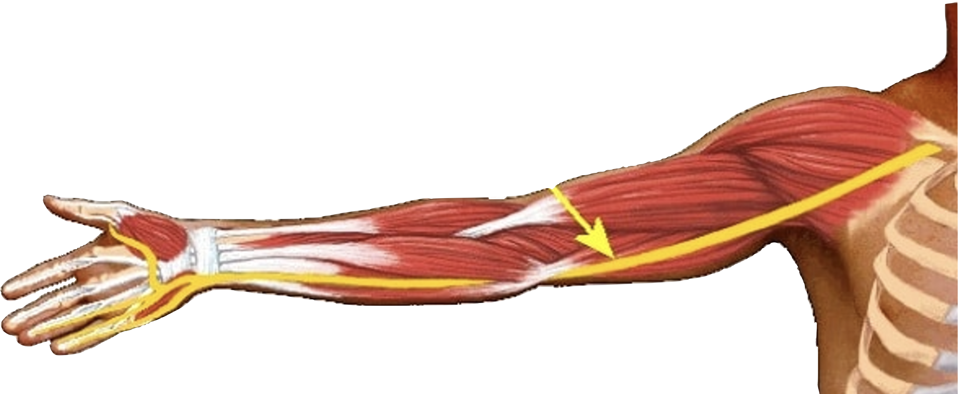
< THE PINKY
AND THE ARTICULATED BONE ON THE BEACH STORY

Slide 13
< BOX 2
R
R
A A A A D D A A E D A E

Slide 14
< BOX 3
R
R
A A A A D D A A E D A E

Slide 15
< BOX 4
R
R
A A A A D D A A E D A E

Slide 16
< BOX 5
R
R
R
A A A A D D A A E D A E

Slide 17
< BB BOX (BOX 2)
R
R
A A A A D D A A E D A E

Slide 18
< THE SWEET SPOT (BOX 4)
R
R
A A A A D D A A E D A E

