Slide 1


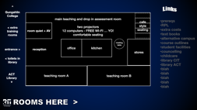
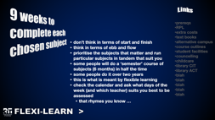
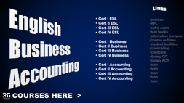

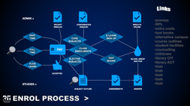
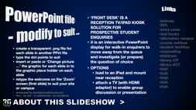
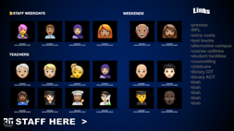
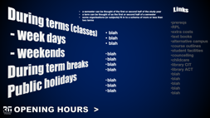
Welcome to Gungahlin CIT (control display on the iPad)

Slide 2

prereqs
RPL
extra costs
text books
alternative campus
course outlines
student facilities
councelling
childcare
library CIT
library ACT
blah
blah
blah
blah
blah
COURSES HERE >

Slide 3
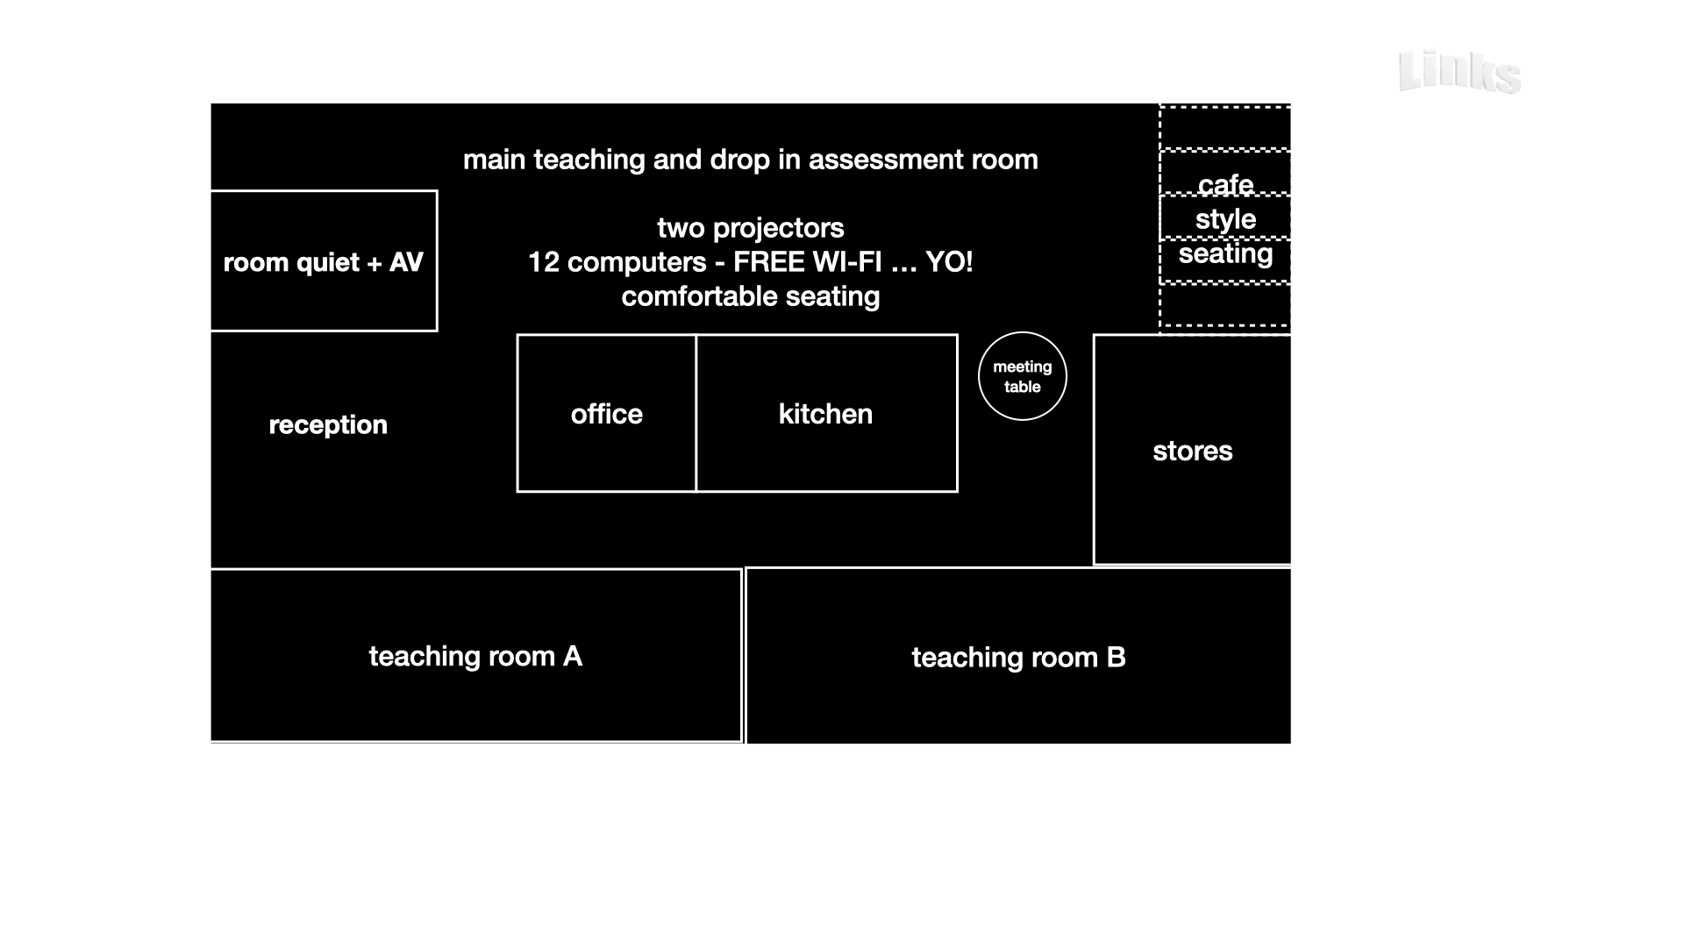
prereqs
RPL
extra costs
text books
alternative campus
course outlines
student facilities
councelling
childcare
library CIT
library ACT
blah
blah
blah
blah
blah
ROOMS HERE >

Slide 4
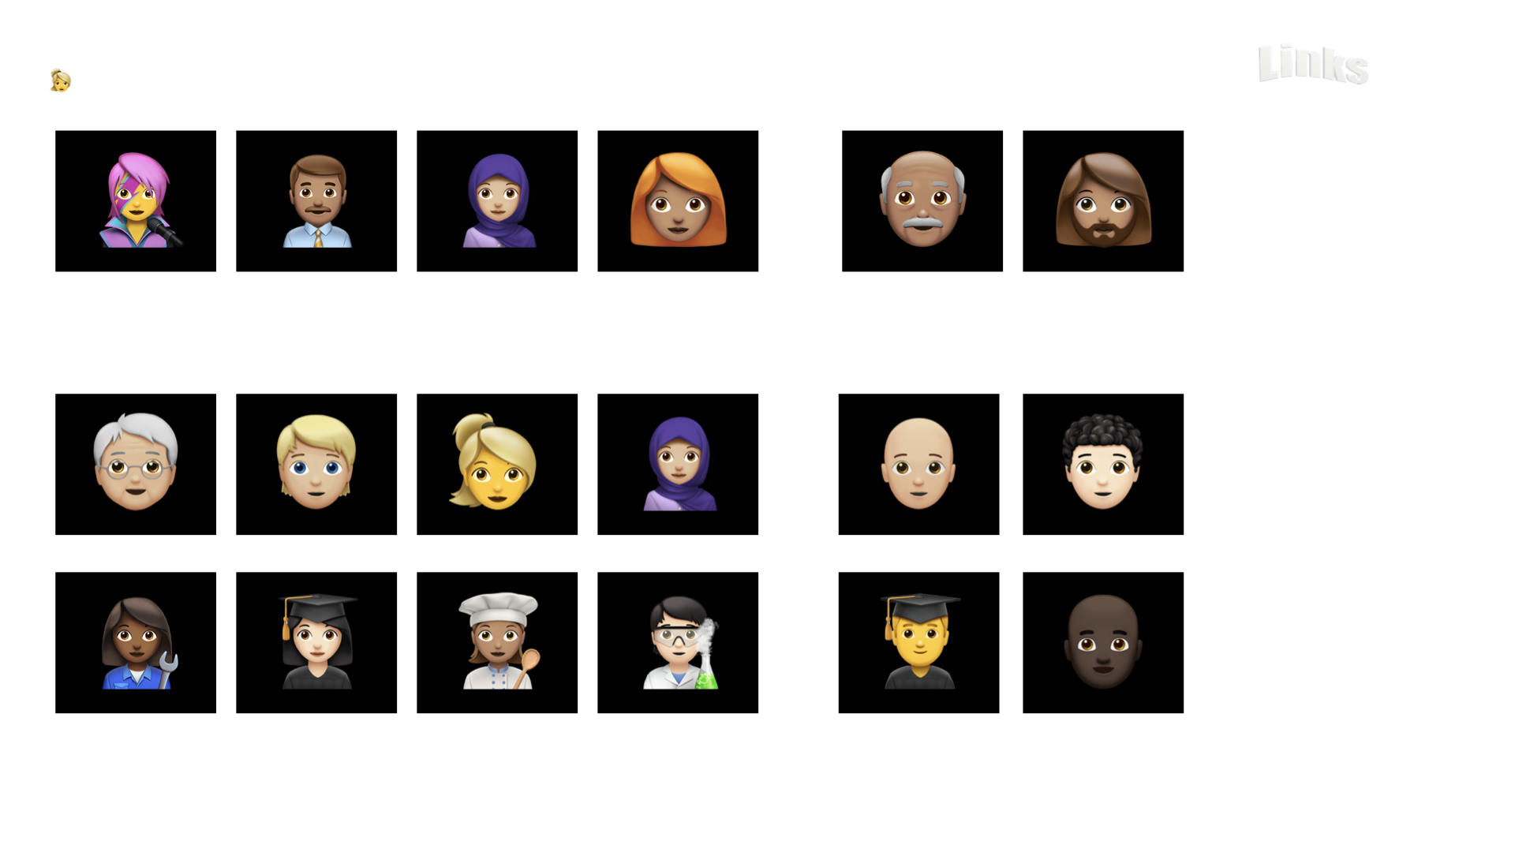
prereqs
RPL
extra costs
text books
alternative campus
course outlines
student facilities
councelling
childcare
library CIT
library ACT
blah
blah
blah
blah
blah
STAFF HERE >

Slide 5
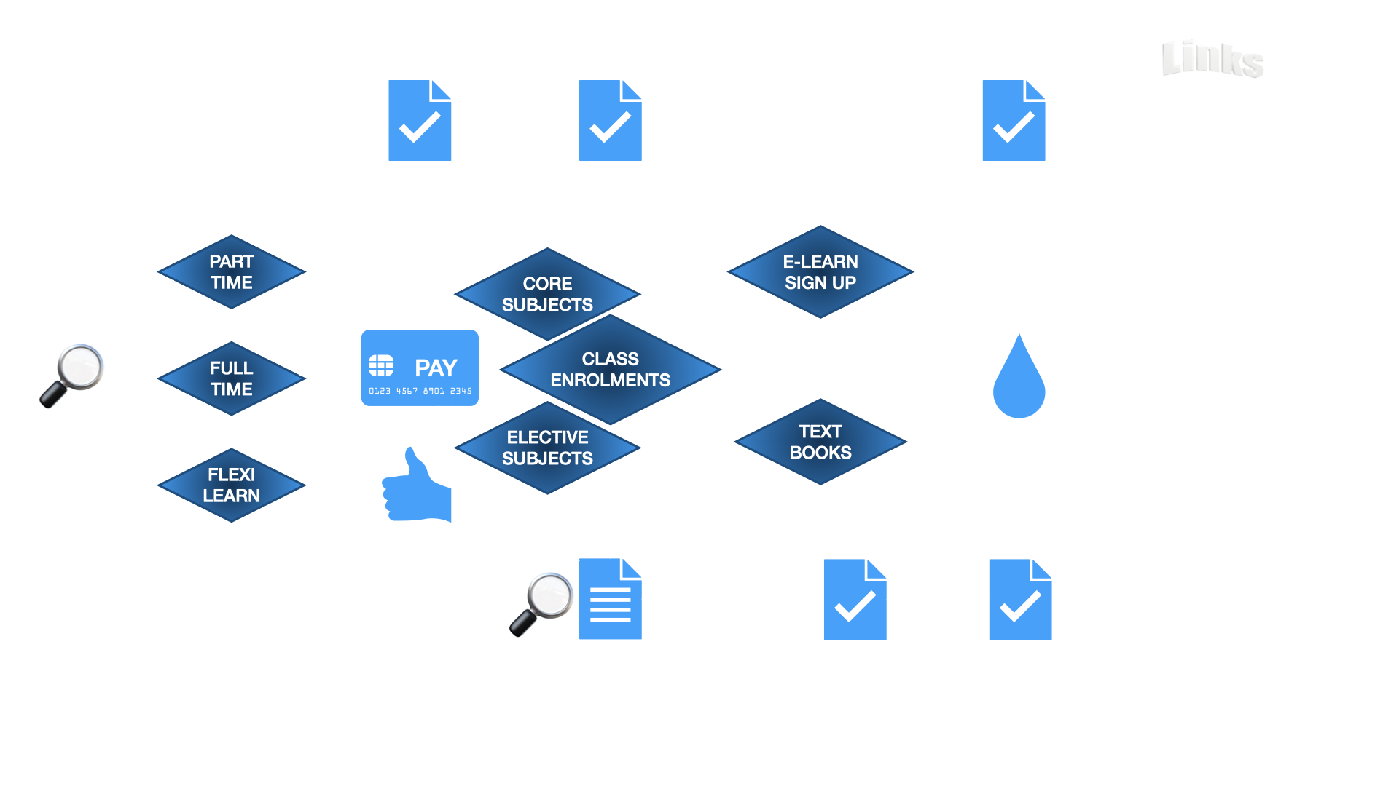
prereqs
RPL
extra costs
text books
alternative campus
course outlines
student facilities
councelling
childcare
library CIT
library ACT
blah
blah
blah
blah
blah
ENROL PROCESS >

Slide 6

prereqs
RPL
extra costs
text books
alternative campus
course outlines
student facilities
councelling
childcare
library CIT
library ACT
blah
blah
blah
blah
blah
FEE-FREE TAFE >

Slide 7

prereqs
RPL
extra costs
text books
alternative campus
course outlines
student facilities
councelling
childcare
library CIT
library ACT
blah
blah
blah
blah
blah
FLEXI-LEARN >

Slide 8
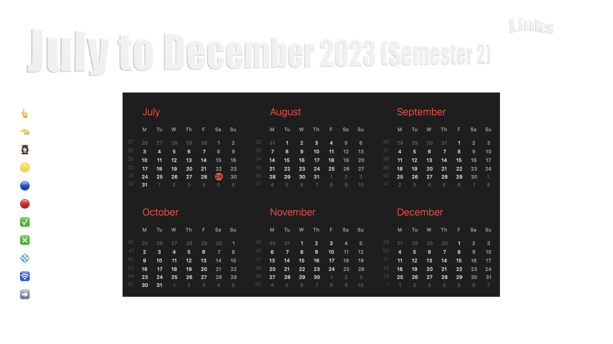
prereqs
RPL
extra costs
text books
alternative campus
course outlines
student facilities
councelling
childcare
library CIT
library ACT
blah
blah
blah
blah
blah
CALENDAR >

Slide 9
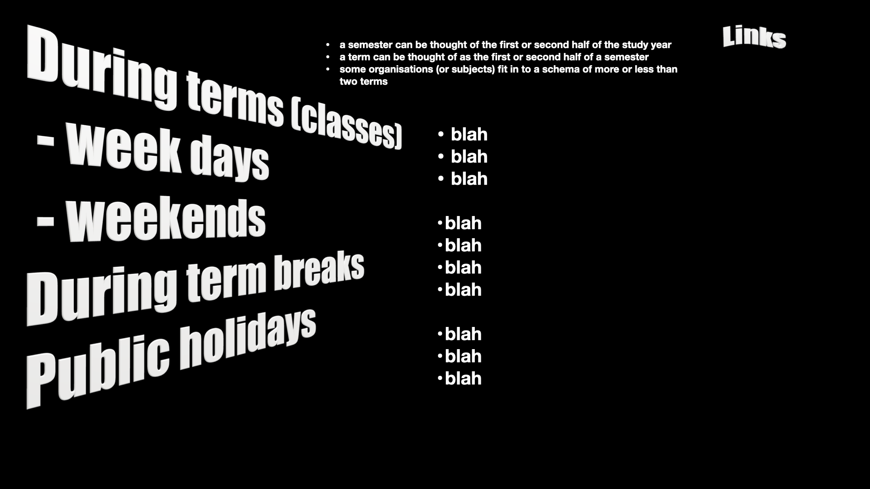
prereqs
RPL
extra costs
text books
alternative campus
course outlines
student facilities
councelling
childcare
library CIT
library ACT
blah
blah
blah
blah
blah
OPENING HOURS >

Slide 10

prereqs
RPL
extra costs
text books
alternative campus
course outlines
student facilities
councelling
childcare
library CIT
library ACT
blah
blah
blah
blah
blah
ABOUT THIS SLIDESHOW >

